Slide 1

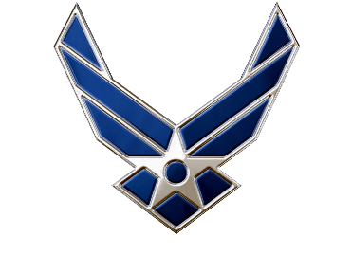

Pass In Review
C/Lt Col Vallor and C/2d Lt Al Luhaibat
Air Force ROTC Detachment 842
The University of Texas at San Antonio

Slide 2
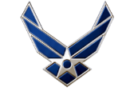
Overview
Placemat
Concept of Operations
Chain of Events
Plan of Action and Milestones
Committee Members and Roles
Equipment
Timeline
Bad Weather Contingency
Questions
Air Force ROTC Detachment 842 • We Build Exceptional Officers • The University of Texas at San Antonio

Slide 3

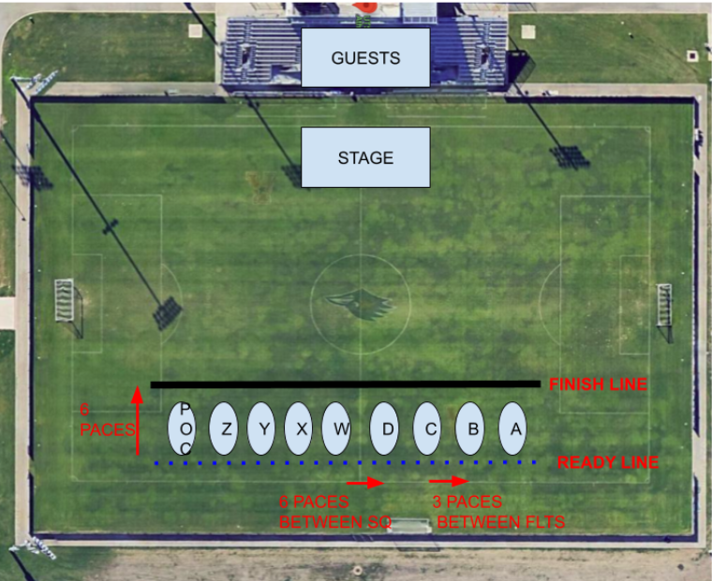
Mission:
UTSA Det 842 will be returning with our official Pass In Review. This event is the culmination of the semester, and will include the changing of command and the review of the Wing by the Commander.
CONOPS:
Pass In Review
Units Tasked:
INTERNAL:
GMC: All Flights
POC: All Flights
EXTERNAL:
UTSA Staff
Concept of the Operation:
Flights will form up at the Park West field by 1645 on 05 December 2024. Accountability will be taken. We will then conduct the changing of command, showcase warrior and honor flight and finally conduct pass and review.
Tasks to Staff:
Force Support - Accountability, food/water
Logistics - Transportation, uniforms
Operations - Review and Conduct D&C
Public Affairs - Provide media coverage (photos/videos), update social media sites
Timeline:
13Oct 2024
Disseminate Information with A3
05Nov2024
Initial practice with Command Staff
12/14thNov2024
Initial practice with ALL POC
19, 21Nov2024
Rec FIeld PT Practices
21NOV2024
1700: Official Wing Practice
03DEC2024
Park West PT Practice
05DEC2024
1600: LLAB team + Add ComSup personnel arrive
1630: Gates Open
1645: Pass and Review Begins
1735: Dismissal
Coordinating Instructions
FOOD: Booster Club
WATER: LLAB Team
UNIFORM: Blues/Alternates
VEHICLES:GOV to transfer equipment/Personal Vehicles
EQUIPMENT: Speakers, microphones, cones
COMMUNICATION: Slack
FUNDING: Detachment
DATE/TIME IDENTIFIED | VENUE CONFIRMED | TRANSPORTATION CONFIRMED | GUESTS CONFIRMED
RECON CONDUCTED | INFORMATION SENT | REHEARSAL CONDUCTED | AAR CONDUCTED
Risk Assessment
Hazard | Initial Risk Level | Mitigated Risk Level
Tripping | Med | Low
Cars/Traffic | Low | Low
Heat Stress | Med | Low

Slide 4
Concept of Operations
Event: Pass In Review
Purpose: Allow commander to inspect the readiness of the detachment
Date: 05 Dec 24
Location: Park West Campus, UTSA
Air Force ROTC Detachment 842 • We Build Exceptional Officers • The University of Texas at San Antonio

Slide 5
Chain of Events
Assembly
Officers Center
Awards
National Anthem
Change of Command
Pass in Review
Flight Time
Air Force ROTC Detachment 842 • We Build Exceptional Officers • The University of Texas at San Antonio

Slide 6

POA&M
Action | Suspense | Status | OPR
Reserve Fields | N/A | Complete | C/Vallor, C/Al Luhaibat
Conduct POC Practices | 21 Nov 2024 | In Progress | C/Vallor, C/Al Luhaibat
Conduct Wing Practices | 5 Dec 2024 | In Progress | C/Vallor, C/Al Luhaibat
Air Force ROTC Detachment 842 • We Build Exceptional Officers • The University of Texas at San Antonio

Slide 7
Committee Members & Roles
Role | Member
Leads | C/Vallor and C/Al Luhaibat
MC | C/Rosner
Set Up/Takedown | C/Cleveland
Food and Drinks | C/Rodriguez, Caden
Audio | C/Dzogbenuku
Air Force ROTC Detachment 842 • We Build Exceptional Officers • The University of Texas at San Antonio

Slide 8
Equipment
Item | Quantity
Signs | TBD
Chairs | 16
Trash Bags | 5
Water Coolers | 1
Pumpkins | 2
Ice | 2 bags
Gatorade Mix | 1
Water Bottles | 2 -> 24 packs
Cups | 2 -> 50 pack
Microphone | 1
Speakers | 2
Tables | 2
Canopy | 2
Cones | 9
Air Force ROTC Detachment 842 • We Build Exceptional Officers • The University of Texas at San Antonio

Slide 9
Timeline
AAR with DO/OFC
05 Dec 24 - Pass in Review
3 Dec - Final PT Practice
21 Nov - Wing Rehearsal
19 Nov 2024 - 3rd IPR
19 Nov - PT Practice
12th/14th Nov. POC Practice
4 Nov. Finalize Equipment
24 Oct 24 - 2nd IPR
10/15 Script Completed
10/14 A3 Info Dissemination
30 Sept 24 – Initial IPR
Air Force ROTC Detachment 842 • We Build Exceptional Officers • The University of Texas at San Antonio

Slide 10
Bad Weather Contingency
In case of Bad Weather, Pass and Review will be cancelled…
Resume normal LLAB procedures at Main Building
Semester Recap Briefing (1600-1630)
Awards
Highlight Events
Change of Command Ceremony (1630-1640)
Spring 2025 Outlook Brief by incoming Command Staff (1640-1700)
Final Flight Time (1700-1735)
Air Force ROTC Detachment 842 • We Build Exceptional Officers • The University of Texas at San Antonio

Slide 11
Questions?

Slide 12
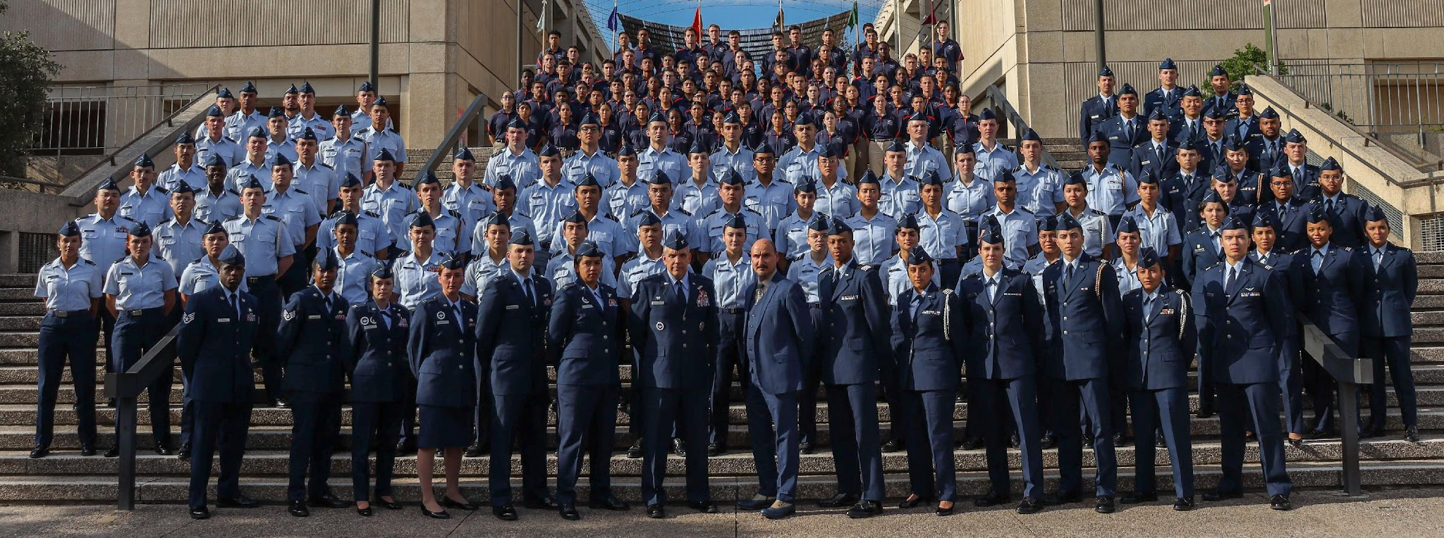
Air Force ROTC Detachment 842
The University of Texas at San Antonio
Det 842 – Best in Blue

